Slide 1
Probabilistic Logics
Logic for Artificial Intelligence
Yi Zhou

Slide 2
  Content
    Propositional probabilistic logic
    Bayesian network
    Markov logic network
    Conclusion

Slide 3
  Content
    Propositional probabilistic logic
    Bayesian network
    Markov logic network
    Conclusion

Slide 4
Propositional Probabilistic Logic
    Representation
        Propositional formulas with probability
        e.g., Pr(x∧y)=0.8,
    Semantics
        Pr(ϕ)= Σw|= ϕ Pr(w)
    Reasoning
        axiom system
        not much can be reasoned

Slide 5
  Content
    Propositional probabilistic logic
    Bayesian network
    Markov logic network
    Conclusion

Slide 6
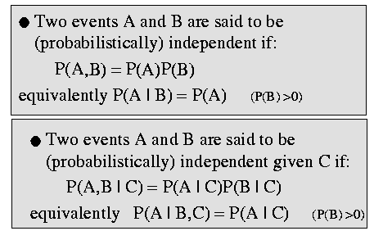
Conditional Probability

Slide 7
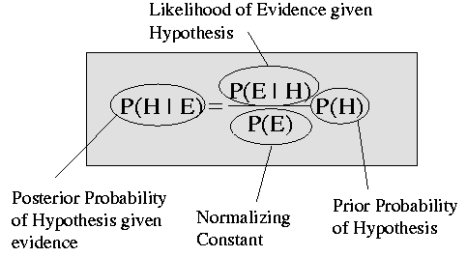
Bayesian Theorem

Slide 8
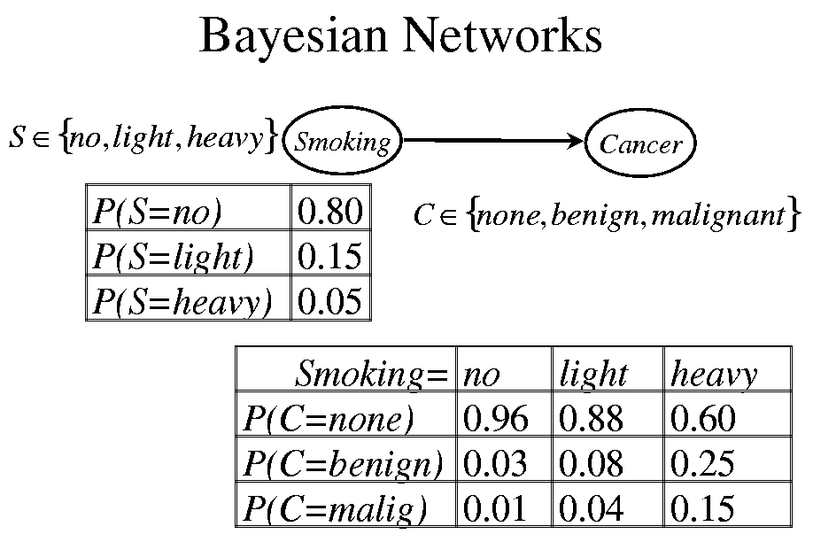
P(S)
P(C|S)
P(S)
P(C|S)

Slide 9
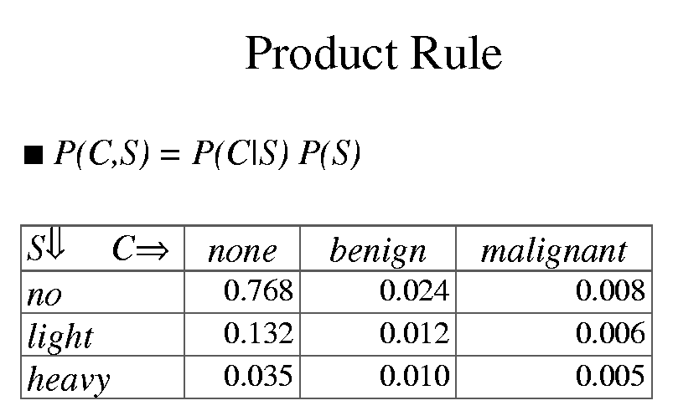

Slide 10
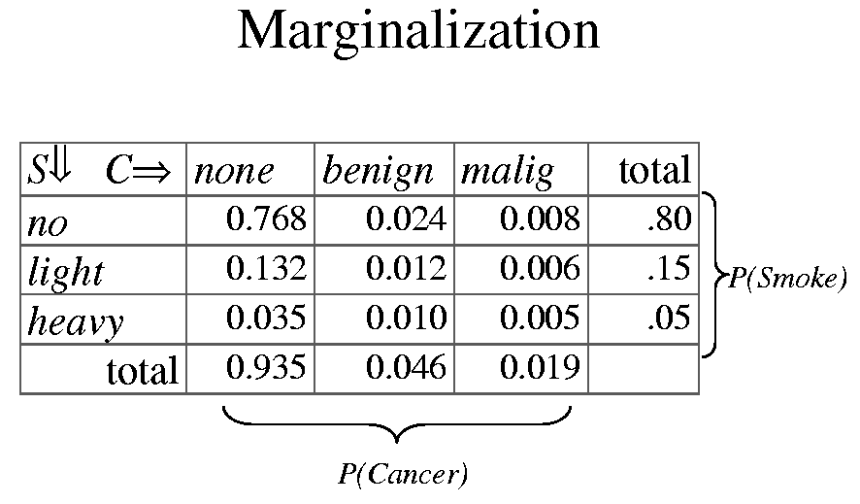

Slide 11
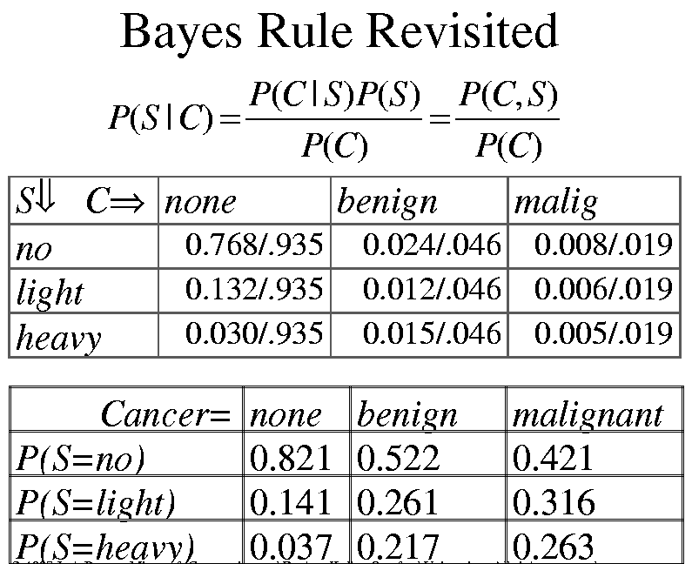

Slide 12
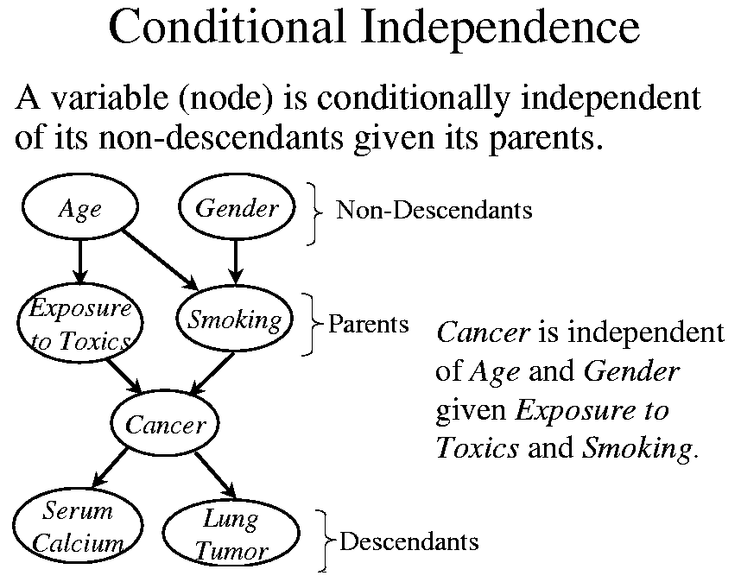

Slide 13
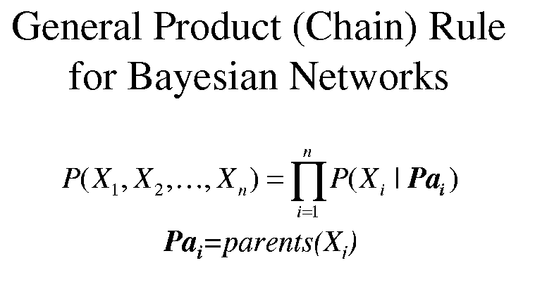

Slide 14
Sample of General Product Rule
X₁
X₂
X₃
X₅
X₄
X₆
p(x₁, x₂, x₃, x₄, x₅, x₆) = p(x₆ | x₅) p(x₅ | x₃, x₂) p(x₄ | x₂, x₁) p(x₃ | x₁) p(x₂ | x₁) p(x₁)

Slide 15
Inference tasks
Simple queries: Computer posterior marginal P(X_{i} | E=e)
  E.g., P(NoGas | Gauge=empty, Lights=on, Starts=false)
Conjunctive queries:
  P(X_{i}, X_{j} | E=e) = P(X_{i} | e=e) P(X_{j} | X_{i}, E=e)
Optimal decisions: Decision networks include utility information; probabilistic inference is required to find P(outcome | action, evidence)
Value of information: Which evidence should we seek next?
Sensitivity analysis: Which probability values are most critical?
Explanation: Why do I need a new starter motor?

Slide 16
Approaches to inference
Exact inference
  Enumeration
  Belief propagation in polytrees
  Variable elimination
  Clustering / join tree algorithms
Approximate inference
  Stochastic simulation / sampling methods
  Markov chain Monte Carlo methods
  Genetic algorithms
  Neural networks
  Simulated annealing
  Mean field theory

Slide 17
Direct inference with BNs
Instead of computing the joint, suppose we just want the probability for one variable
Exact methods of computation:
  Enumeration
  Variable elimination
Join trees: get the probabilities associated with every query variable

Slide 18
Inference by enumeration
Add all of the terms (atomic event probabilities) from the full joint distribution
If E are the evidence (observed) variables and Y are the other (unobserved) variables, then:
    P(X|e) = α P(X, E) = α ∑ P(X, E, Y)
Each P(X, E, Y) term can be computed using the chain rule
Computationally expensive!

Slide 19
Example: Enumeration
a
b c
d e
P(x_{i}) = Σ _{πi} P(x_{i} | π_{i}) P(π_{i})
Suppose we want P(D=true), and only the value of E is given as true
P (d|e) = α Σ_{ABC}P(a, b, c, d, e)
= α Σ_{ABC}P(a) P(b|a) P(c|a) P(d|b,c) P(e|c)
With simple iteration to compute this expression, there’s going to be a lot of repetition (e.g., P(e|c) has to be recomputed every time we iterate over C=true)

Slide 20
Exercise: Enumeration
p(smart)=.8
p(study)=.6
smart
study
p(fair)=.9
prepared
fair
p(prep|…) | smart | ¬smart
study | .9 | .7
¬study | .5 | .1
pass
p(pass|…) | smart |  | ¬smart
 | prep | ¬prep | prep | ¬prep
fair | .9 | .7 | .7 | .2
¬fair | .1 | .1 | .1 | .1
Query: What is the probability that a student studied, given that they pass the exam?

Slide 21
Building BN Structures
Problem
Domain
Probability
Elicitor
Bayesian
Network
Expert
Knowledge
Problem
Domain
Learning
Algorithm
Bayesian
Network
Training
Data
Problem
Domain
Learning
Algorithm
Bayesian
Network
Expert
Knowledge
Training
Data

Slide 22
Learning Probabilities from Data
Exploit conjugate distributions
  Prior and posterior distributions in same family
  Given a pre-defined functional form of the likelihood
For probability distributions of a variable defined between 0 and 1, and associated with a discrete sample space for the likelihood
  Beta distribution for 2 likelihood states (e.g., head on a coin toss)
  Multivariate Dirichlet distribution for 3+ states in likelihood space

Slide 23
Learning BN Structure from Data
Entropy Methods
  Earliest method
  Formulated for trees and polytrees
Conditional Independence (CI)
  Define conditional independencies for each node (Markov boundaries)
  Infer dependencies within Markov boundary
Score Metrics
  Most implemented method
  Define a quality metric to maximize
  Use greedy search to determine the next best arc to add
  Stop when metric does not increase by adding an arc
Simulated Annealing & Genetic Algorithms
  Advancements over greedy search for score metrics

Slide 24
Features for Adding Knowledge to Learning Structure
Define Total Order of Nodes
Define Partial Order of Nodes by Pairs
Define “Cause & Effect” Relations

Slide 25
  Content
    Propositional probabilistic logic
    Bayesian network
    Markov logic network
    Conclusion

Slide 26
Markov Logic
Syntax: Weighted first-order formulas
Semantics: Templates for Markov nets
Inference: WalkSAT, MCMC, KBMC
Learning: Voted perceptron, pseudo-likelihood, inductive logic programming.

Slide 27
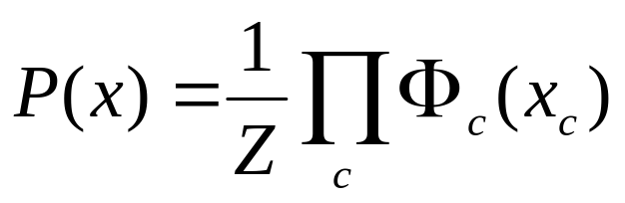
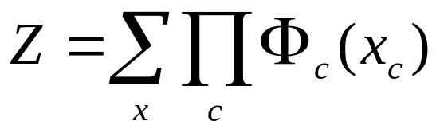
Markov Networks
Undirected graphical models
Smoking
Cancer
Asthma
Cough
Potential functions defined over cliques
Smoking | Cancer | Ф(S,C)
False | False | 4.5
False | True | 4.5
True | False | 2.7
True | True | 4.5

Slide 28
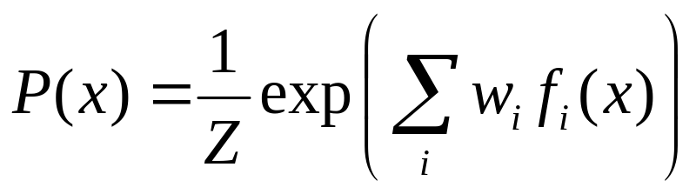
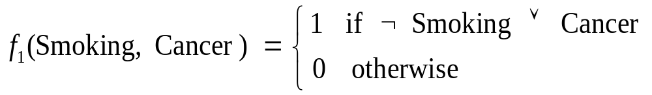

Markov Networks
Undirected graphical models
Smoking
Cancer
Asthma
Cough
Log-linear model:
Weight of Feature i
Feature i

Slide 29
First-Order Logic
Constants, variables, functions, predicates
E.g.: Anna, x, MotherOf(x), Friends(x,y)
Grounding: Replace all variables by constants
E.g.: Friends (Anna, Bob)
World (model, interpretation):
Assignment of truth values to all ground predicates

Slide 30
Definition
A Markov Logic Network (MLN) is a set of pairs (F, w) where
  F is a formula in first-order logic
  w is a real number
Together with a set of constants,
it defines a Markov network with
  One node for each grounding of each predicate in the MLN
  One feature for each grounding of each formula F in the MLN, with the corresponding weight w

Slide 31
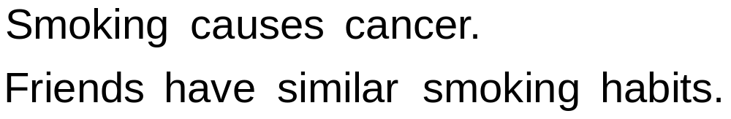
Example: Friends & Smokers

Slide 32
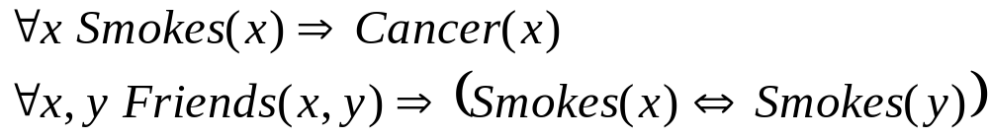
Example: Friends & Smokers

Slide 33

Example: Friends & Smokers

Slide 34
Example: Friends & Smokers
Two constants: Anna (A) and Bob (B)

Slide 35
Example: Friends & Smokers
Two constants: Anna (A) and Bob (B)
Smokes(A)
Smokes(B)
Cancer(A)
Cancer(B)

Slide 36
Example: Friends & Smokers
Two constants: Anna (A) and Bob (B)
Friends(A,B)
Friends(A,A)
Smokes(A)
Smokes(B)
Friends(B,B)
Cancer(A)
Cancer(B)
Friends(B,A)

Slide 37
Example: Friends & Smokers
Two constants: Anna (A) and Bob (B)
Friends(A,B)
Friends(A,A)
Smokes(A)
Smokes(B)
Friends(B,B)
Cancer(A)
Cancer(B)
Friends(B,A)

Slide 38
Example: Friends & Smokers
Two constants: Anna (A) and Bob (B)
Friends(A,B)
Friends(A,A)
Smokes(A)
Smokes(B)
Friends(B,B)
Cancer(A)
Cancer(B)
Friends(B,A)

Slide 39
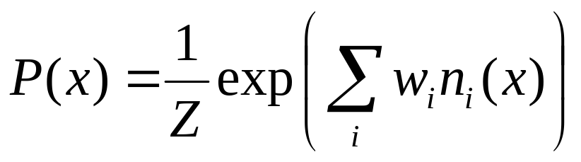
Markov Logic Networks
MLN is template for ground Markov nets
Probability of a world x:
Typed variables and constants greatly reduce size of ground Markov net
Functions, existential quantifiers, etc.
Infinite and continuous domains
Weight of formula i
No. of true groundings of formula i in x

Slide 40
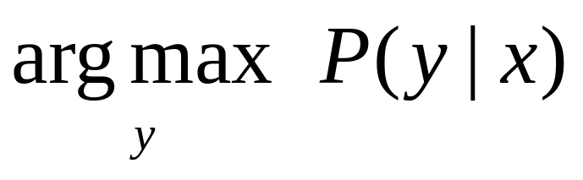
MAP/MPE Inference
Problem: Find most likely state of world given evidence
Query
Evidence

Slide 41
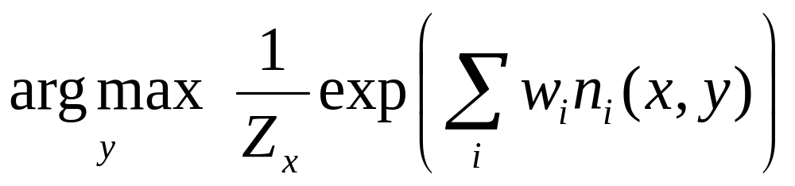
MAP/MPE Inference
Problem: Find most likely state of world given evidence

Slide 42
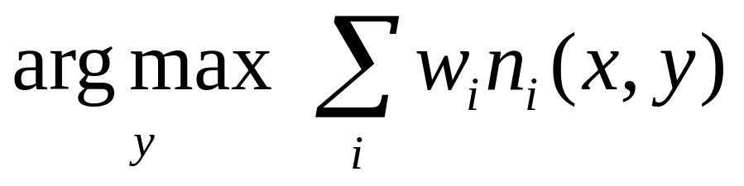
MAP/MPE Inference
Problem: Find most likely state of world given evidence

Slide 43
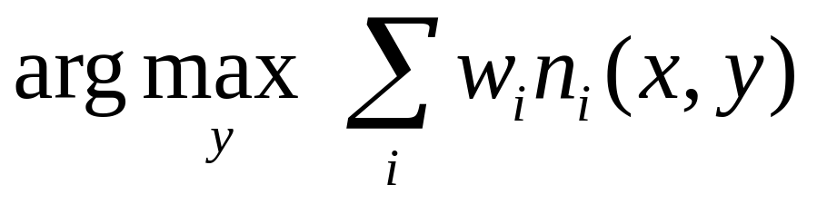
MAP/MPE Inference
Problem: Find most likely state of world given evidence
This is just the weighted MaxSAT problem
Use weighted SAT solver
(e.g., MaxWalkSAT [Kautz et al., 1997] )
Potentially faster than logical inference (!)

Slide 44
The WalkSAT Algorithm
for i ← 1 to max-tries do
solution = random truth assignment
for j ← 1 to max-flips do
if all clauses satisfied then
return solution
c ← random unsatisfied clause
with probability p
flip a random variable in c
else
flip variable in c that maximizes
number of satisfied clauses
return failure

Slide 45
The MaxWalkSAT Algorithm
for i ← 1 to max-tries do
solution = random truth assignment
for j ← 1 to max-flips do
if ∑ weights(sat. clauses) > threshold then
return solution
c ← random unsatisfied clause
with probability p
flip a random variable in c
else
flip variable in c that maximizes
∑ weights(sat. clauses)
return failure, best solution found

Slide 46
But … Memory Explosion
Problem:
If there are n constants
and the highest clause arity is c,
the ground network requires O(n ) memory
Solution:
Exploit sparseness; ground clauses lazily
→ LazySAT algorithm [Singla & Domingos, 2006]
c

Slide 47
Computing Probabilities
P(Formula|MLN,C) = ?
MCMC: Sample worlds, check formula holds
P(Formula1|Formula2,MLN,C) = ?
If Formula2 = Conjunction of ground atoms
  First construct min subset of network necessary to answer query (generalization of KBMC)
  Then apply MCMC (or other)
Can also do lifted inference [Braz et al, 2005]

Slide 48
Ground Network Construction
network ← Ø
queue ← query nodes
repeat
node ← front(queue)
remove node from queue
add node to network
if node not in evidence then
add neighbors(node) to queue
until queue = Ø

Slide 49
MCMC: Gibbs Sampling
state ← random truth assignment
for i ← 1 to num-samples do
for each variable x
sample x according to P(x|neighbors(x))
state ← state with new value of x
P(F) ← fraction of states in which F is true

Slide 50
But … Insufficient for Logic
Problem:
Deterministic dependencies break MCMC
Near-deterministic ones make it very slow
Solution:
Combine MCMC and WalkSAT
→ MC-SAT algorithm [Poon & Domingos, 2006]

Slide 51
Learning
Data is a relational database
Closed world assumption (if not: EM)
Learning parameters (weights)
  Generatively
  Discriminatively
Learning structure (formulas)

Slide 52
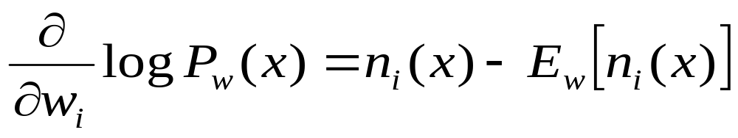
Generative Weight Learning
Maximize likelihood
Use gradient ascent or L-BFGS
No local maxima
Requires inference at each step (slow!)
No. of true groundings of clause i in data
Expected no. true groundings according to model

Slide 53
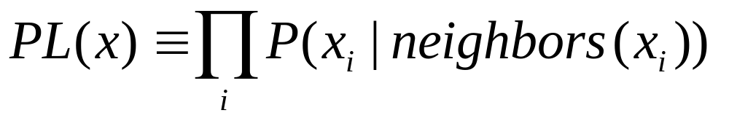
Pseudo-Likelihood
Likelihood of each variable given its neighbors in the data [Besag, 1975]
Does not require inference at each step
Consistent estimator
Widely used in vision, spatial statistics, etc.
But PL parameters may not work well for
long inference chains

Slide 54
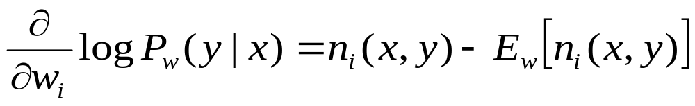
Discriminative Weight Learning
Maximize conditional likelihood of query (y) given evidence (x)
Approximate expected counts by counts in MAP state of y given x
No. of true groundings of clause i in data
Expected no. true groundings according to model

Slide 55
Voted Perceptron
Originally proposed for training HMMs discriminatively [Collins, 2002]
Assumes network is linear chain
w_{i} ← 0
for t ← 1 to T do
y_{MAP} ← Viterbi(x)
w_{i} ← w_{i} + η [count_{i}(y_{Data}) – count_{i}(y_{MAP})]
return ∑_{t} w_{i} / T

Slide 56
Voted Perceptron for MLNs
HMMs are special case of MLNs
Replace Viterbi by MaxWalkSAT
Network can now be arbitrary graph
w_{i} ← 0
for t ← 1 to T do
y_{MAP} ← MaxWalkSAT(x)
w_{i} ← w_{i} + η [count_{i}(y_{Data}) – count_{i}(y_{MAP})]
return ∑_{t} w_{i} / T

Slide 57
Structure Learning
Generalizes feature induction in Markov nets
Any inductive logic programming approach can be used, but . . .
Goal is to induce any clauses, not just Horn
Evaluation function should be likelihood
Requires learning weights for each candidate
Turns out not to be bottleneck
Bottleneck is counting clause groundings
Solution: Subsampling

Slide 58
Structure Learning
Initial state: Unit clauses or hand-coded KB
Operators: Add/remove literal, flip sign
Evaluation function:
Pseudo-likelihood + Structure prior
Search:
  Beam [Kok & Domingos, 2005]
  Shortest-first [Kok & Domingos, 2005]
  Bottom-up [Mihalkova & Mooney, 2007]

Slide 59
  Content
    Propositional probabilistic logic
    Bayesian network
    Markov logic network
    Conclusion

Slide 60
Applications
    Information retrieval
    Link prediction
    Machine learning
    Semantic parsing

Slide 61
Probabilistic logics
    Propositional probabilistic logic = propositional logic + probability
    First-order probabilistic logic = propositional probabilistic logic + first-order quantifier
    Bayesian network = propositional probabilistic logic + conditional dependence represented by DAG
    Markov logic network = first-order probabilistic logic + conditional dependence represented by undirected graph
    Representation, reasoning, learning

Slide 62
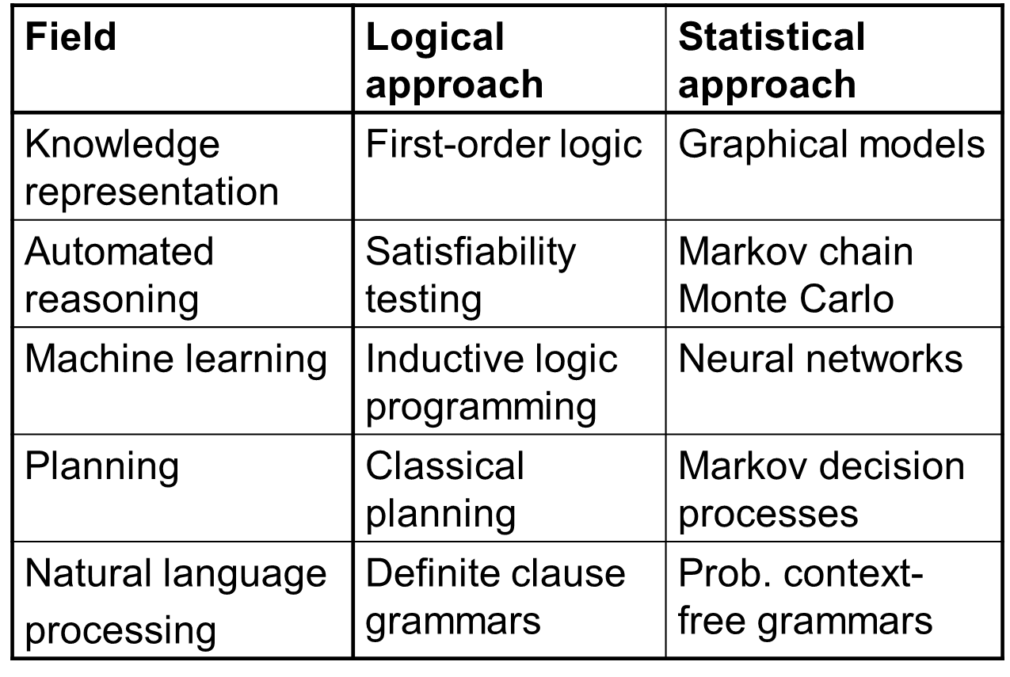
Classical logics vs Probabilistic logics

Slide 63

Thank you!

